Slide 1
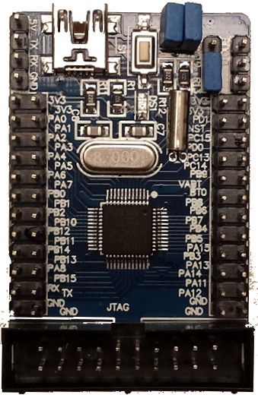
Power
5V
TX LNK_RX
Serial
RX LNK_TX
GND
BOOT_0
BOOT_1
AnalogIn
3V3
3V3
3V3
3V3
PA_0
PA_1
NST
PD_1
PA_2GPS_RX
PA_3GPS_TX
PD_0
PC_15
DigitalIn
PA_4 JOY_A1
PA_5JOY_A2
PC_14
PC_13
PA_6 JOY_B1
PA_7JOY_B2
VBAT
PB_9
PB_0 BUZZ
PB_1 OK_A
PB_8
BT_0
DigitalOut
PB_2 OK_B
PB_10
PB_7
PB_6 L-RTH
PB_12 LOC
PB_11 ARM
PB_5 L-ALT
PB_4 EN_ESP
PwmOut
PB_14 RTH
PB_13 ALT
PB_3
PA_15
PA_8 L-ARM
PB_15 L-LOC
PA_14
PA_13
RX LNK_TX
TX LNK_RX
PA_12
PA_11
Not used
GND
GND
GND
GND

Slide 2
Power
5V
Serial
TX LNK_RX
RX LNK_TX
GND
BOOT_0
BOOT_1
AnalogIn
3V3
3V3
3V3
3V3
PA_0
PA_1
NST
PD_1
PA_2GPS_RX
PA_3GPS_TX
PD_0
PC_15
DigitalIn
PA_4 JOY_A1
PA_5JOY_A2
PC_14
PC_13
PA_6 JOY_B1
PA_7JOY_B2
VBAT
PB_9
PB_0 BUZZ
PB_1 OK_A
PB_8
BT_0
DigitalOut
PB_2 OK_B
PB_10
PB_7
PB_6 L-RTH
PB_12 LOC
PB_11 ARM
PB_5 L-ALT
PB_4 EN_ESP
PB_14 RTH
PB_13 ALT
PB_3
PA_15
PwmOut
PA_8 L-ARM
PB_15 L-LOC
PA_14
PA_13
RX LNK_TX
TX LNK_RX
PA_12
PA_11
GND
GND
GND
GND
Not used

Slide 3
Programador ESP8266
GND
3V3
POWER_OFF
PREPARE_FLASH_PROG
CTS Marrón
RTS Verde
RX_PC Amarillo
TX_PC Naranja
GND Negro
5V rojo
OFF/ON
1
2
3
4
TX
EN
RST
3V3
GND
IO2
IO0
RX
POWER & RESET
READY FOR FLASH PROG
10k
POWER CYCLE
START APPLICATION

Slide 4
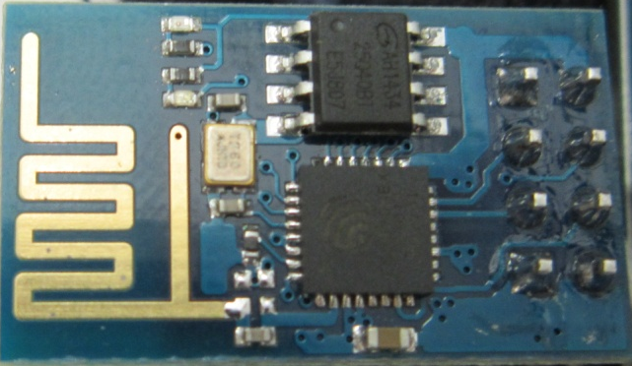
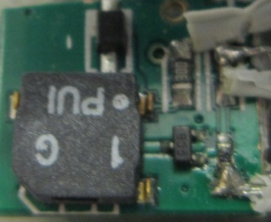
Posicionamiento Periféricos
STM32F103
RX
IO0
IO2
GND
3V3
RST
EN
TX
ESP-01
Buzzer
3V3
BUZ
GND

Slide 5
Carcasa plástica
81mm
25mm
49mm
37mm
13mm
5mm
31mm

